Slide 1
Using Data Flows in Azure Data Factory
Mohabuth Zubayr M
Seewochurn Preety M
Busgeeth Pravesh K

Slide 2
Agenda
Introduction to Azure Data Factory
Role of Azure Data Lake Storage
Data Manipulation in Azure Data Factory
Power BI Report

Slide 3

Introduction – Azure Data Factory
Azure Data Factory
A Big data service that is responsible for the data transformation and processes using scheduled data-driven workflows.
Use of Azure Data Factory helps in creation and scheduling of workflows which uses data from data stores. Processes like ETL and ELT are carried out and built using compute services such as Azure HDInsight, Azure Databricks, and Azure SQL Database.

Slide 4
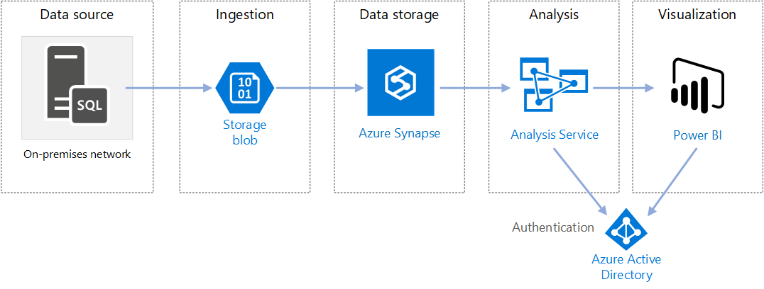
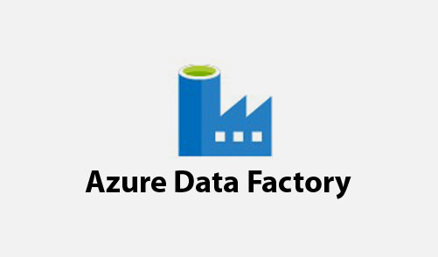
Data Manipulation and Analysis Overview

Slide 5
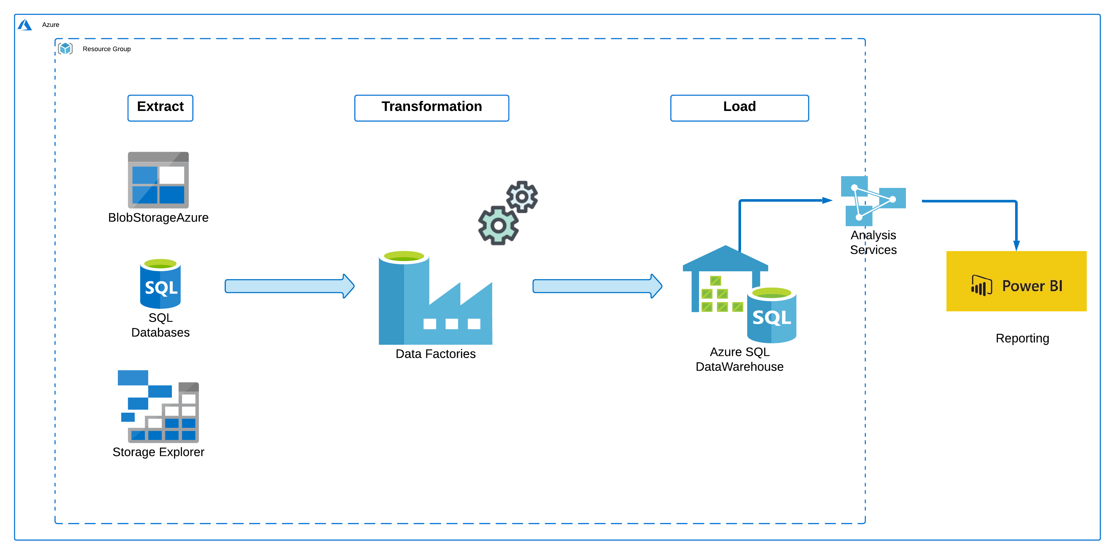
ETL Scenario
IPSEN

Slide 6
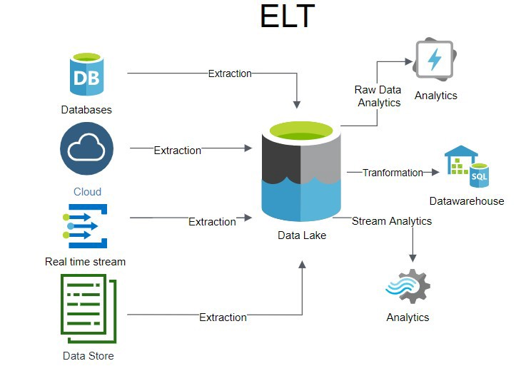
ELT Scenario

Slide 7
Comparison
ETL | ELT
Generally deals with small amount of Data | High amount of Data
Data Transformation is done within the staging area itself which is in the Azure Data Factory and then load into the Datawarehouse. | Transformation of Data performed in the datawarehouse
Both fact and dimensions need to be available in staging area | All data will be available because Extract and load occur in a single action.

Slide 8
Azure Data Factory – Main Components
Pipelines:
A pipeline is a logical grouping of activities that ingests data from an Azure blob to perform a task.
Datasets:
Datasets represent data structures within the data stores, which simply point to or reference the data you want to use in your activities as inputs or outputs.
Mapping Data Flow:
A visually designed data transformation logic, requires no coding skills that are executed on a completely managed Spark cluster

Slide 9
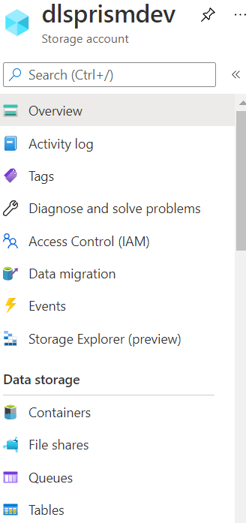
Introduction - Azure Storage Account
Azure Storage Account
Contains different types of storage like Containers, File shares, Queues and Tables.
Microsoft Azure allows developers to store the data in the cloud.

Slide 10
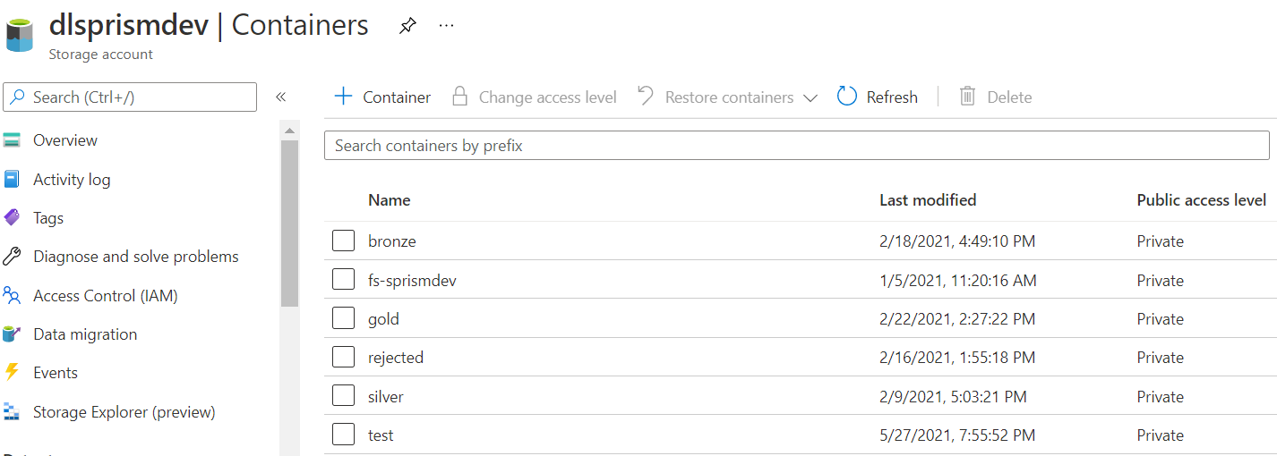
Azure Storage Account
Under Storage Account, we have different Containers in which data has been stored. Data is also highly secure in azure storage as data is written in an encrypted form. To control who can access the data azure provides users with fine-grained control. An Azure Storage Account contains a specific URL.

Slide 11
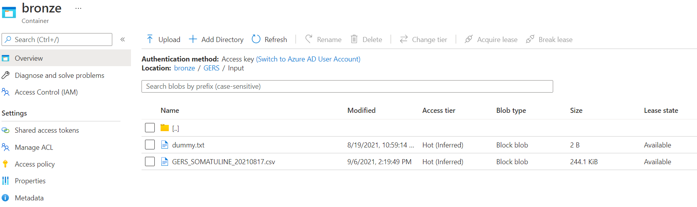
Azure Storage Account Features
Container:
A Container may consist of several folders in which there are different sizes of files/blobs needed for transformation in the Azure Data Factory. Each folders have a specific path or location.

Slide 12
Data Ingestion – Granularity in Data Flow
LAYERS | RULES
BRONZE | No Transformations Ingested files are archive in a folder
SILVER | Technical control Ingested files are archived in a folder
GOLD | Detect Relationships with other table (Account, Product, Event,…) Check dependencies before loading data in DWH
DWH (DATA WAREHOUSE) | Transformed data updated in table

Slide 13
Azure Data Factory
Road to Power BI Report

Slide 14
Steps in ADF
Upload File to Azure Blob Storage
Create Working Branch
Create Datasets - (Source, destination)
Create Data Flow - (Technical Transformation of Data)
Create Pipeline & Orchestrate Pipeline
Deployment via Azure DevOps
Scheduling

Slide 15
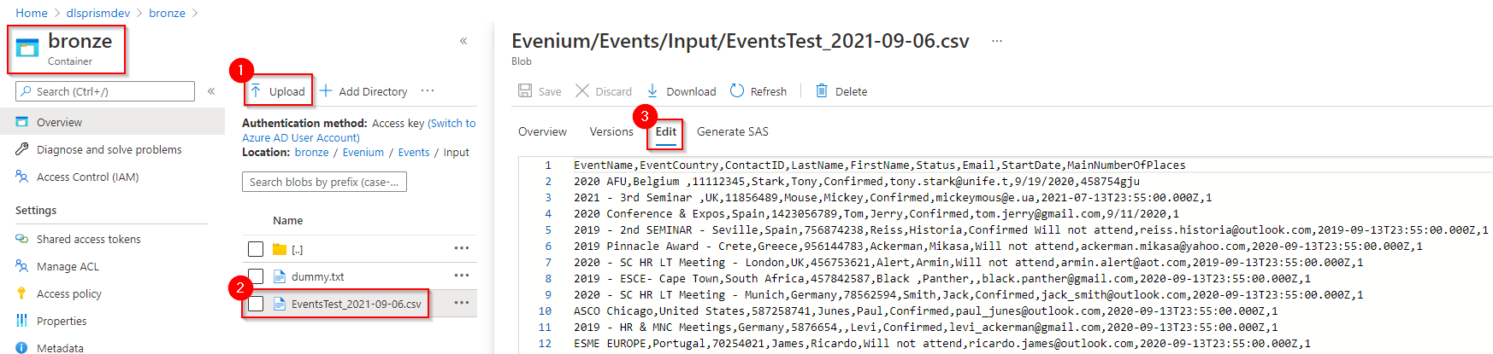
Upload Events.csv file in Blob
Lowest level of granularity
Go to Bronze Container and upload the Events.csv file.
From the grid cell, click on the file and go to Edit to view how the data are stored insides.
The header is found in the first row followed by the data in the rows below separated by comma.

Slide 16
Steps in ADF
Upload File to Azure Blob Storage
Create Working Branch
Create Datasets - (Source, destination)
Create Data Flow - (Technical Transformation of Data)
Create Pipeline & Orchestrate Pipeline
Deployment via Azure DevOps
Scheduling

Slide 17
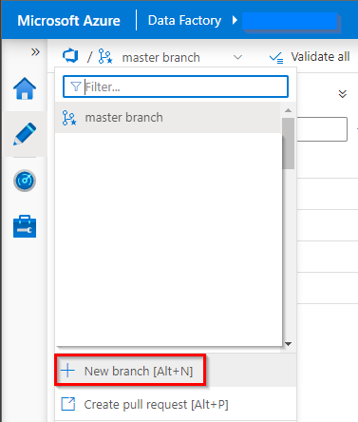
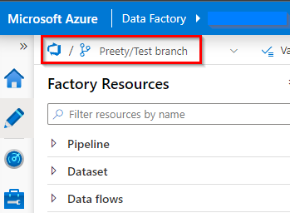
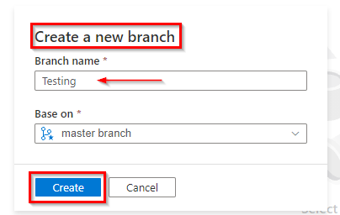
Create Branch
Each development team member needs to create his/her specific branch to do the necessary changes before merging into master branch

Slide 18
Steps in ADF
Upload File to Azure Blob Storage
Create Working Branch
Create Datasets - (Source, destination)
Create Data Flow - (Technical Transformation of Data)
Create Pipeline & Orchestrate Pipeline
Deployment via Azure DevOps
Scheduling

Slide 19
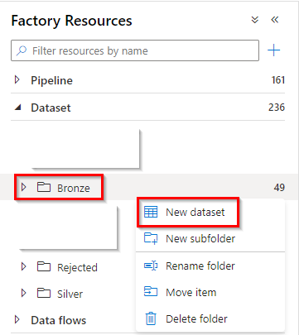
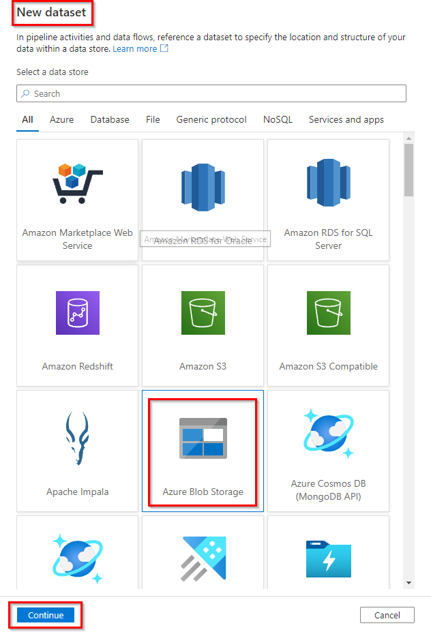
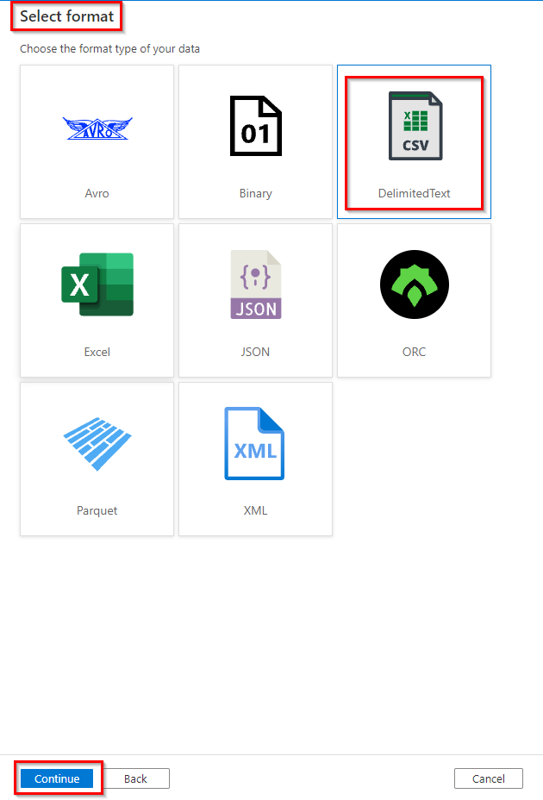
Creation of Input Dataset
We need to define a dataset by specifying the location and structure of the data within a data store

Slide 20
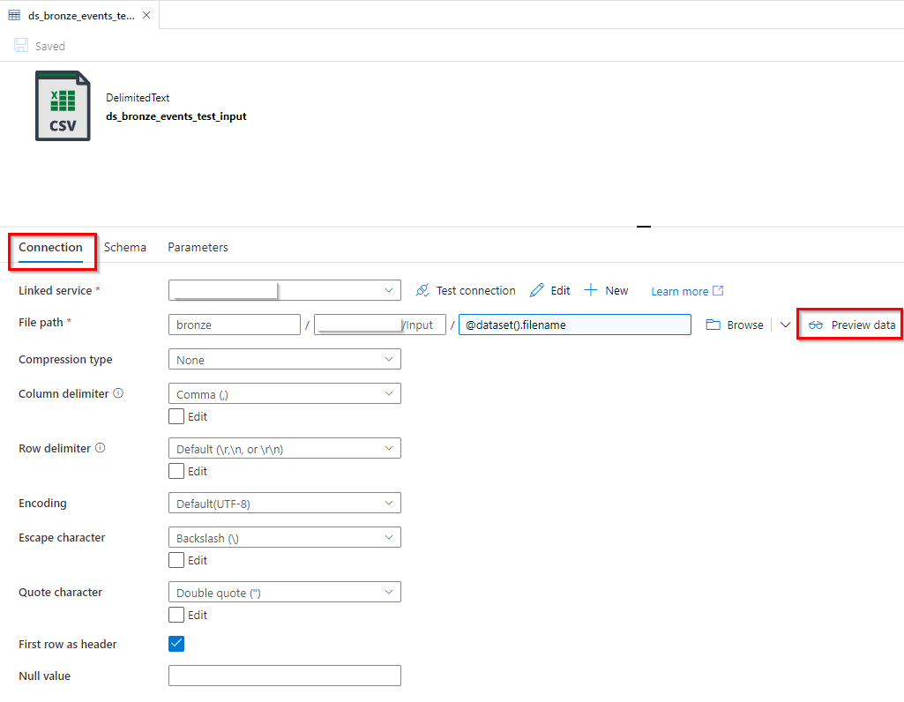
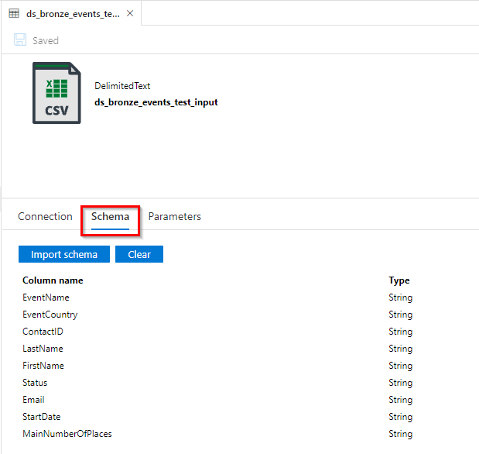
Creation of Input Dataset

Slide 21
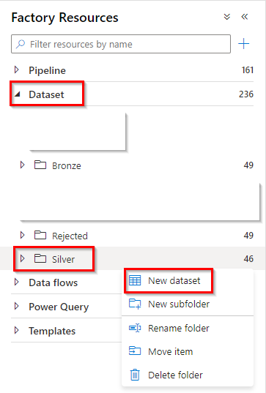
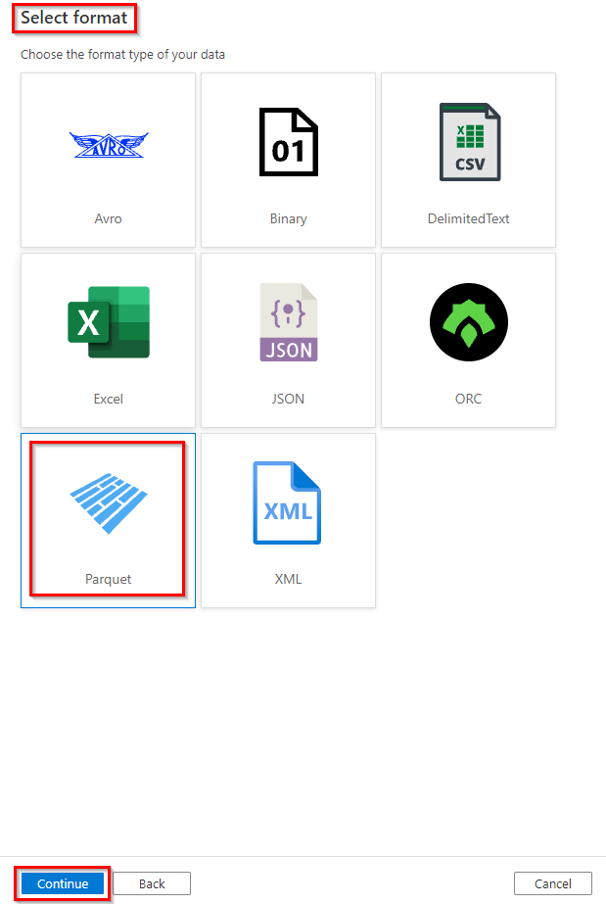
Creation of Output Dataset
Parquet files

Slide 22
Steps in ADF
Upload File to Azure Blob Storage
Create Working Branch
Create Datasets - (Source, destination)
Create Data Flow - (Technical Transformation of Data)
Create Pipeline & Orchestrate Pipeline
Deployment via Azure DevOps
Scheduling
Reporting in Power BI

Slide 23
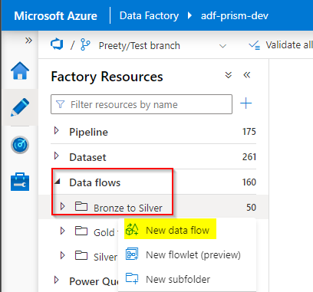
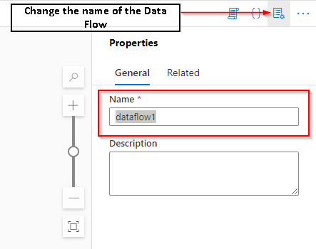
Creation of Data Flow
Data flow allow to develop data transformation logic without writing code.

Slide 24
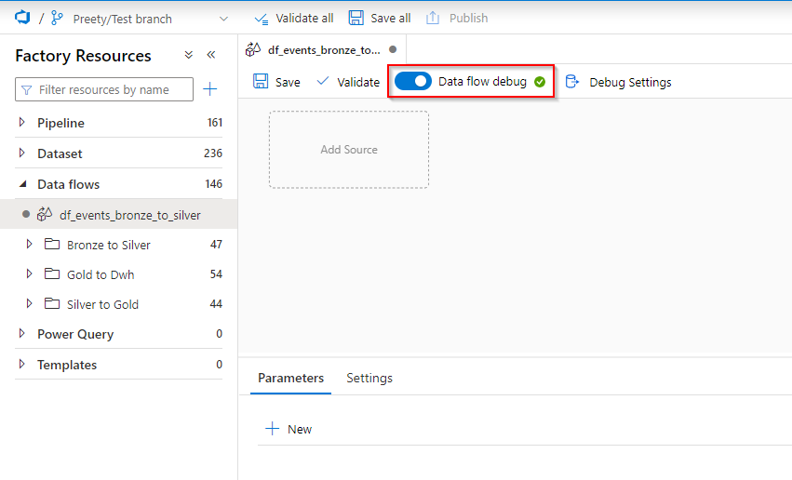
Creation of Data Flow – Data Flow Debug
Data flow debug allows us to preview data at each step of transformation.

Slide 25
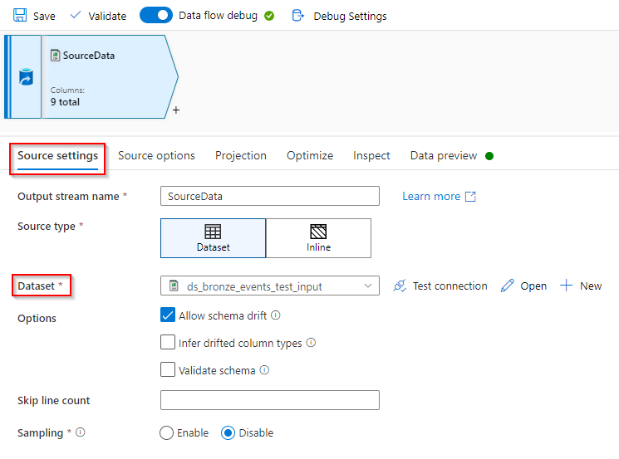
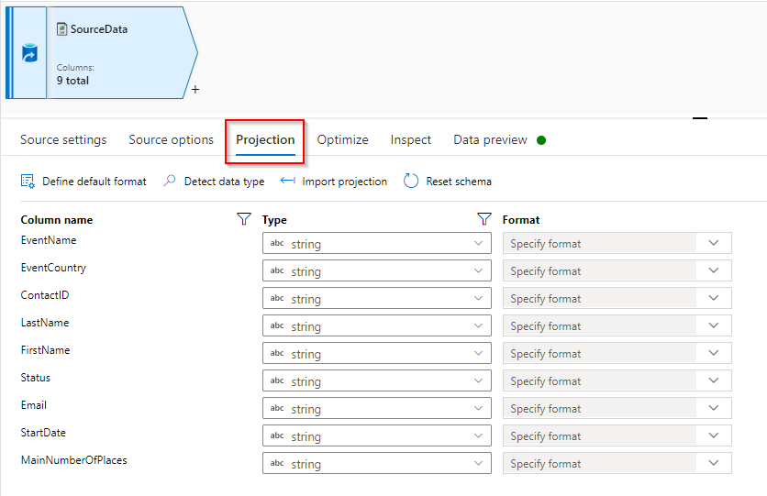
Creation of Data Flow – Transformation Logics
1. Source : Allows to read the Events.csv file

Slide 26
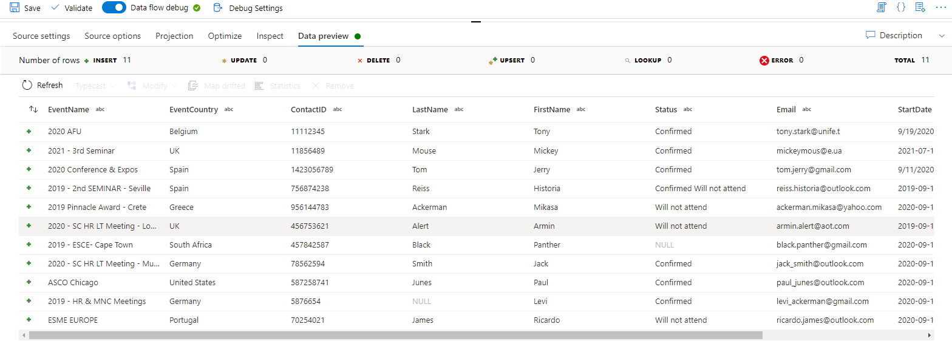
Creation of Data Flow – Transformation Logics
1. Source : Allows to read the Events.csv file

Slide 27
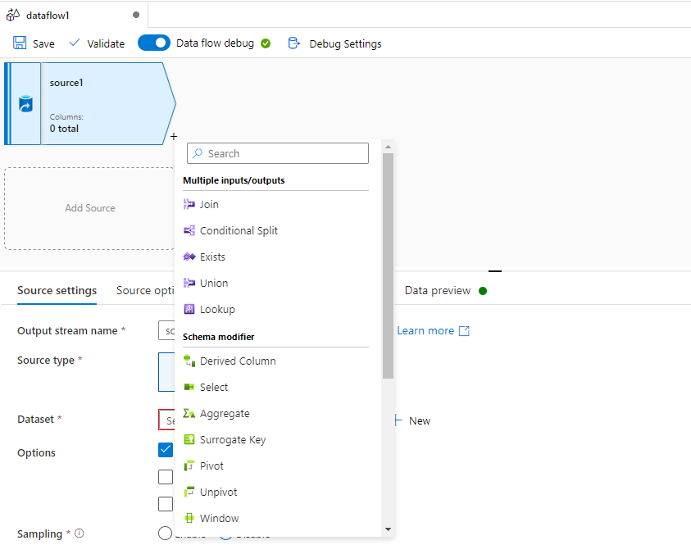
Creation of Data Flow – Transformation Logics
To add a new transformation rule, select the + sign. This provides a list of transformation logic.

Slide 28
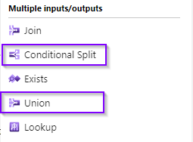
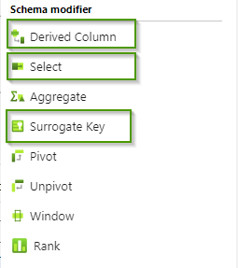
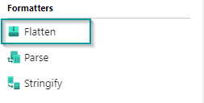
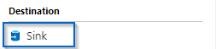
Creation of Data Flow – Transformation Logics
Common Transformation logics that will be used for this example:

Slide 29
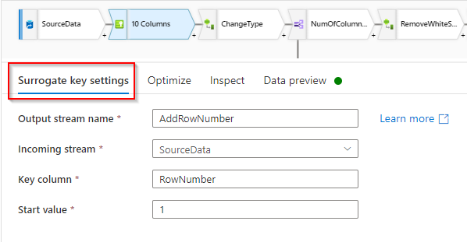
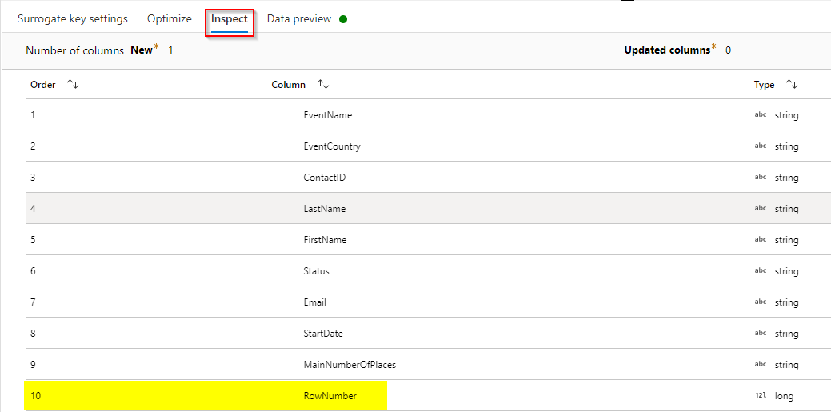
Creation of Data Flow – Transformation Logics
2. Surrogate Key : Allows you to add an incrementing key value to each row of data

Slide 30
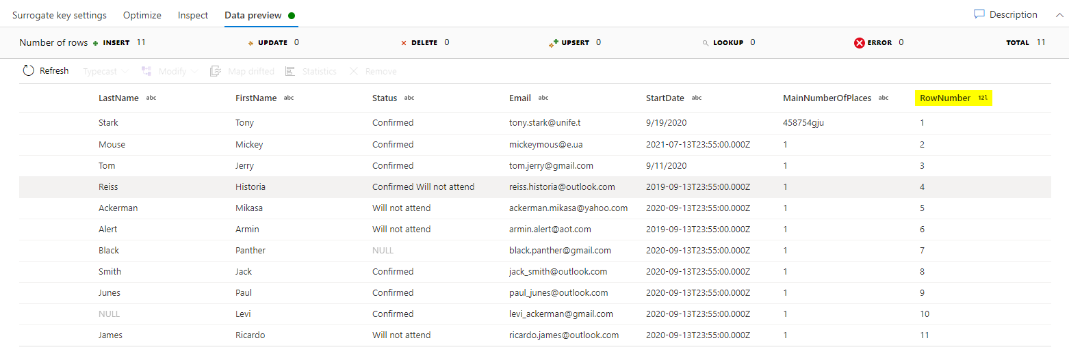
Creation of Data Flow – Transformation Logics
2. Surrogate Key : Allows you to add an incrementing key value to each row of data

Slide 31
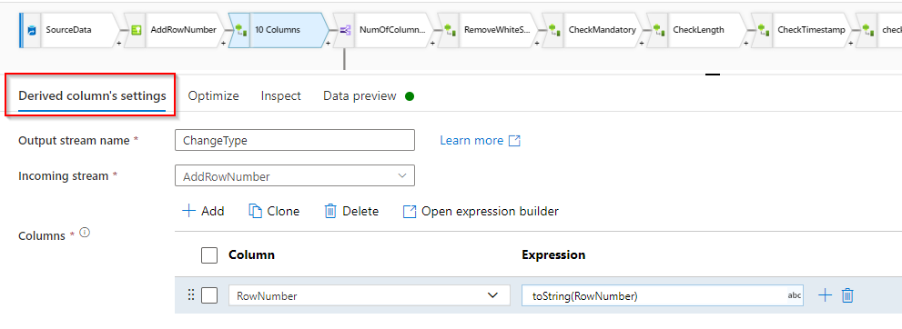
Creation of Data Flow – Transformation Logics
3. Derived Column : Allows you to generate new columns or modify existing column
3.1 Modifying existing column : Changing the data type of RowNumber from Long to String
Notes:
To build the derived column’s expression, click on either Enter Expression textbox or open the expression builder to construct your logic

Slide 32
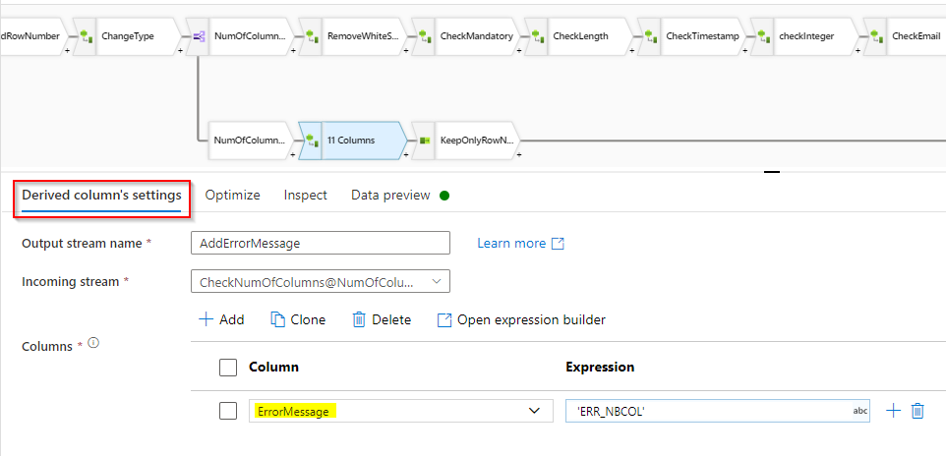
Creation of Data Flow – Transformation Logics
3. Derived Column : Allows you to generate new columns or modify existing column
3.2 Generating a new column, ErrorMessage

Slide 33
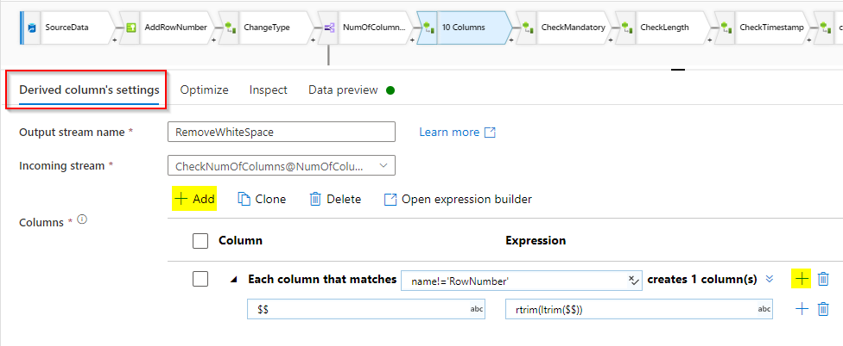
Creation of Data Flow – Transformation Logics
3. Derived Column : enables you to choose from either Add Column or Add Column Pattern
Notes:
To add more Derived Columns, click on Add above the column list or the plus icon next to an existing derived column.
Choose either Add Column or Add Column Pattern.
You choose Add Column Pattern in case where your schema is not explicitly defined or if you want to update a set of columns in bulk.

Slide 34
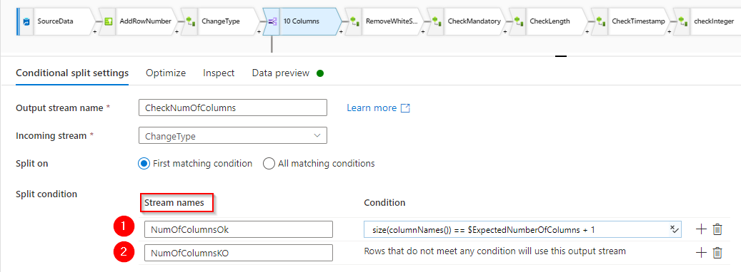
Creation of Data Flow – Transformation Logics
4. Conditional Split : Routes data rows to different streams based on the matching conditions
Notes:
We have 2 streams :
NumOfColumnsOk
NumOfColumnsKO
Routes data rows to different streams based on the matching conditions, i.e. , if the number of columns from Events.csv equals to the expected number of columns (which is 9) + 1 (‘RowNumber’) directs the data rows to the ‘NumOfColumnsOk’ stream or else the data rows will be directed to the ‘NumOfColumnsKO’ stream.

Slide 35
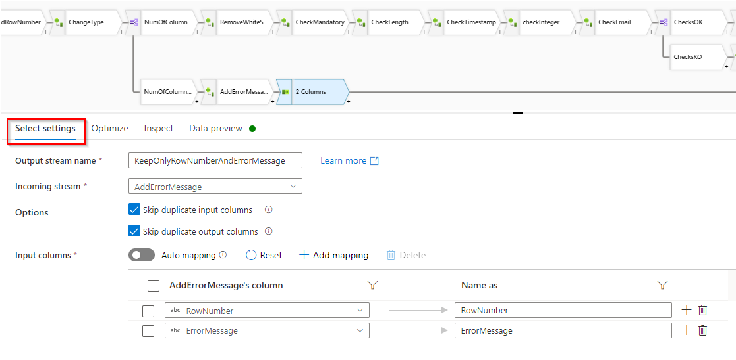
Creation of Data Flow – Transformation Logics
5. Select : Enables you to select required columns

Slide 36
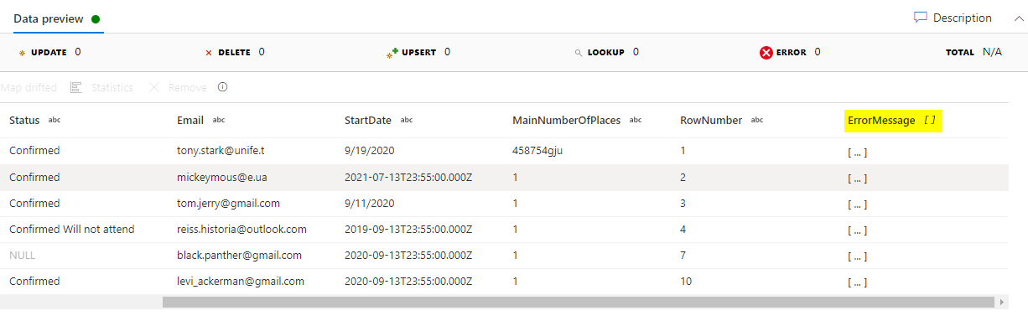
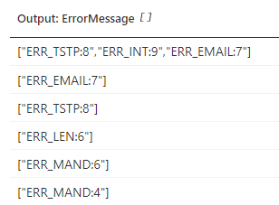
Creation of Data Flow – Transformation Logics
6. Flatten : take array values insides hierarchical structured such as JSON and unroll them into individual rows

Slide 37
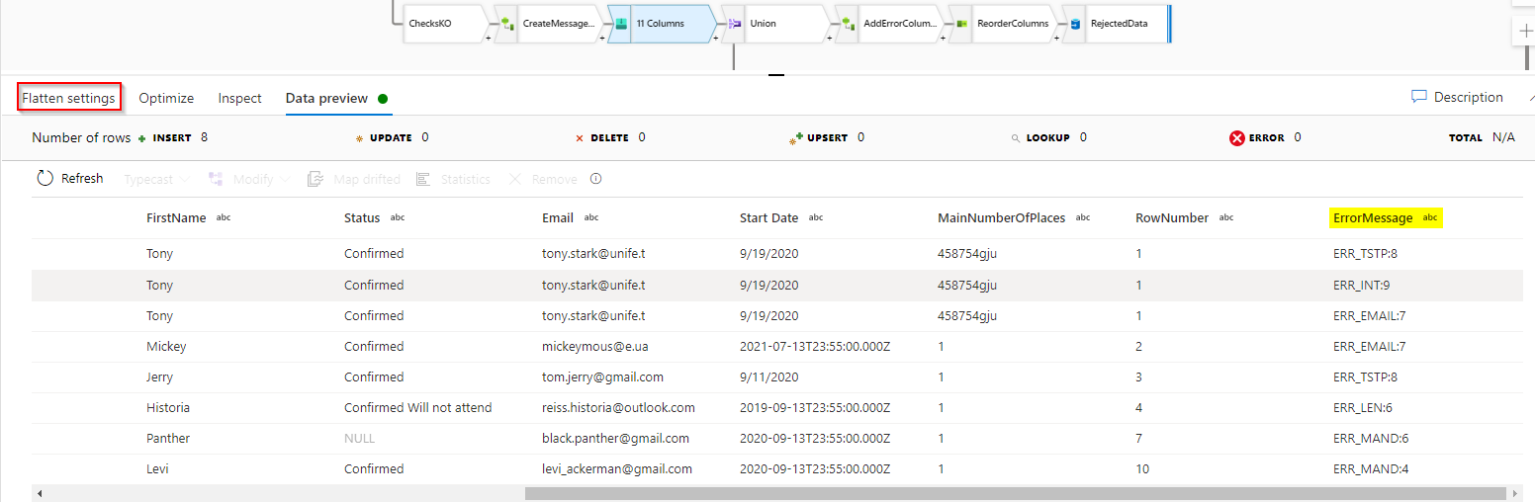
Creation of Data Flow – Transformation Logics
6. Flatten : take array values insides hierarchical structured such as JSON and unroll them into individual rows

Slide 38
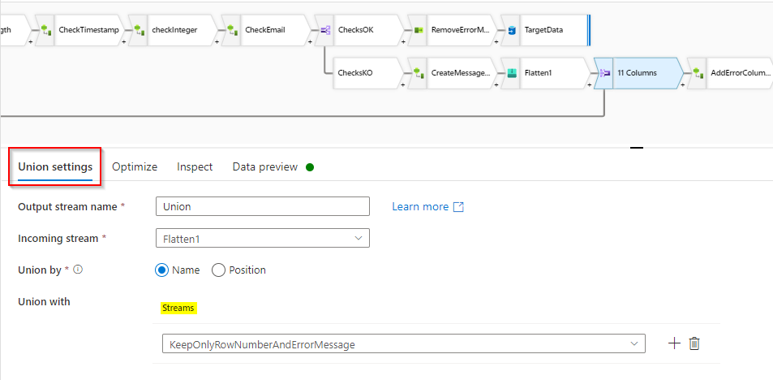
Creation of Data Flow – Transformation Logics
7. Unions : Merge two or more streams into one

Slide 39
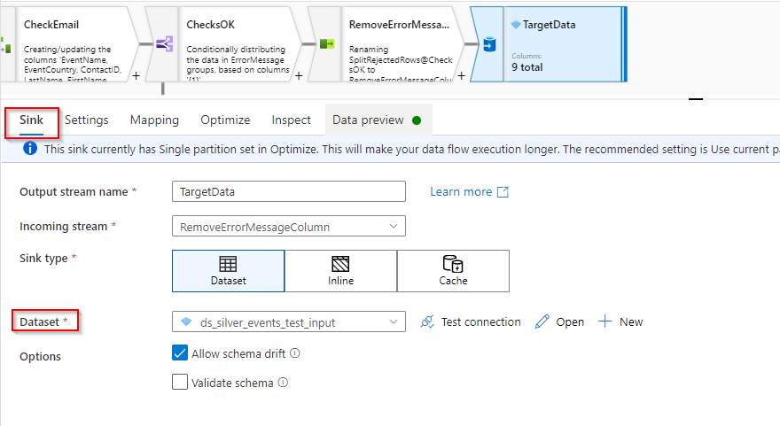
Creation of Data Flow – Transformation Logics
8. Sink : Write to parquet

Slide 40
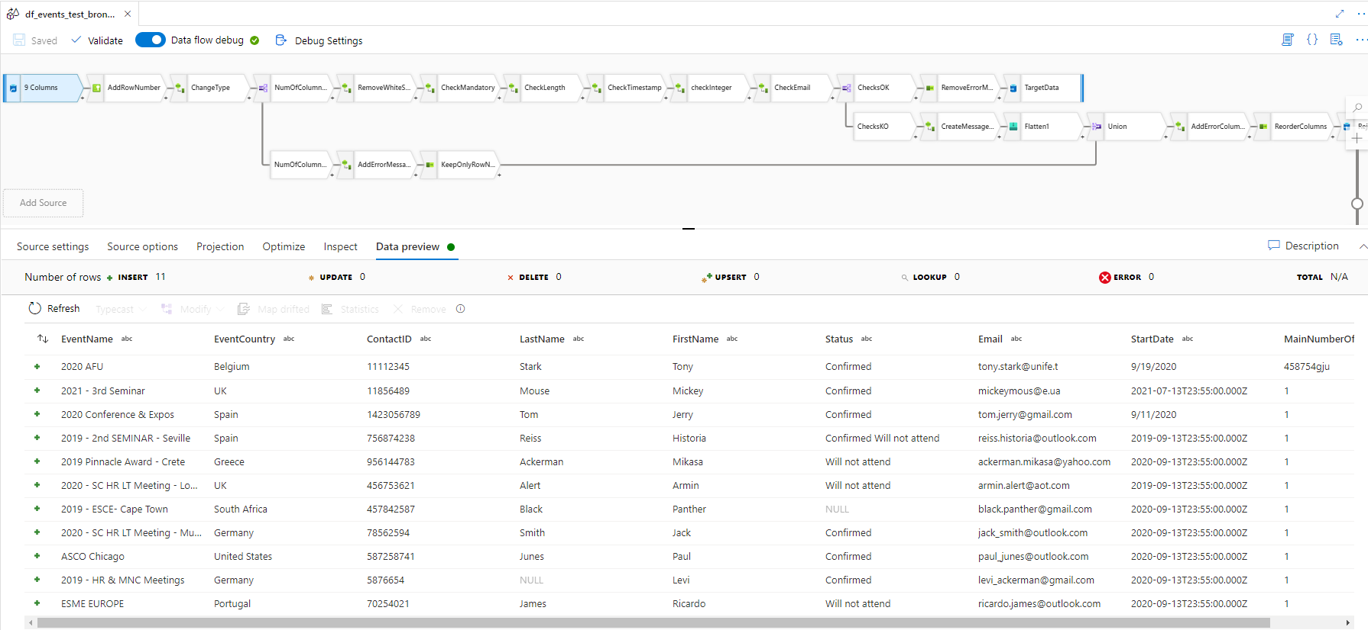
Data Transformation – Data Flow

Slide 41
Steps in ADF
Upload File to Azure Blob Storage
Create Working Branch
Create Datasets - (Source, destination)
Create Data Flow - ( Technical Transformation of Data)
Create Pipeline & Orchestrate Pipeline
Deployment via Azure DevOps
Scheduling

Slide 42
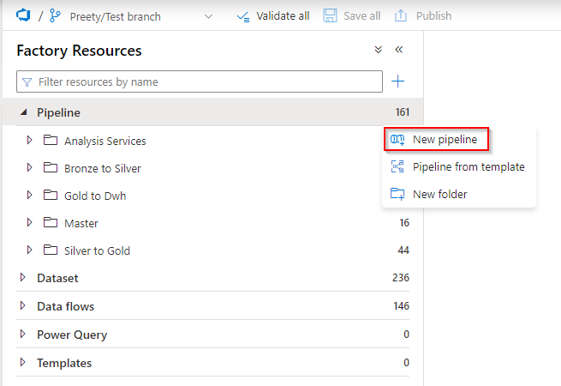
Creation of Pipelines
Pipeline is a logical grouping of activities that together perform a task.
Notes:
For example, Pipeline can have a set of activities that take data from ADLS and perform some transformation of data using U-SQL and load data in SQL DB
Pipelines are created from the Factory Resources panel. To create a pipeline, select the ellipsis next to Pipelines and then select New pipeline.
On the Right side of the screen click on the Properties icon to rename the pipeline with a meaningful name.

Slide 43
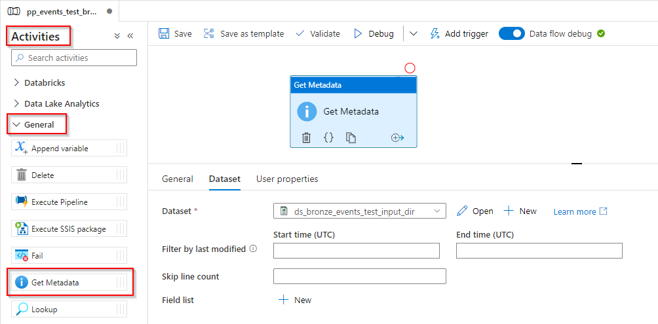
Creation of Pipelines – Get Metadata
Notes:
Metadata activity can be used to retrieve specific metadata types such as lastModified, structure, itemType, ItemName, exists etc.
Example: If you want to validate a table or file which exists, specifying 'exists' in the Metadata activity will check if the file exist and will return true or false.
If the file is not found, the MetaData activity will fail.

Slide 44
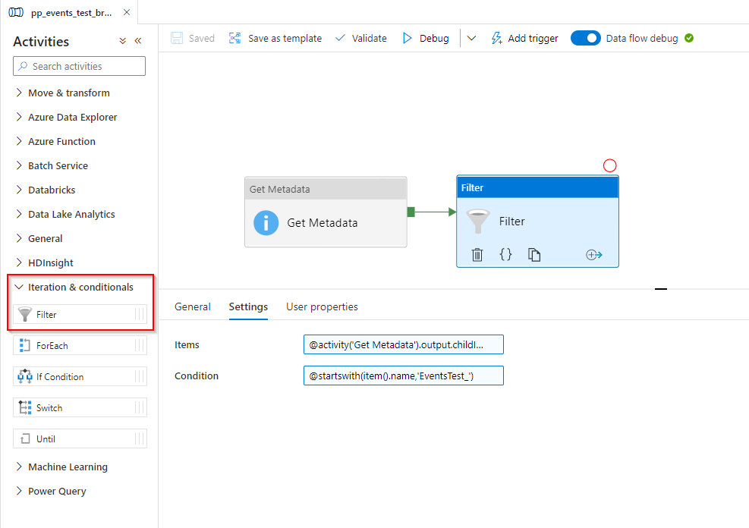
Creation of Pipelines – Add Filter

Slide 45
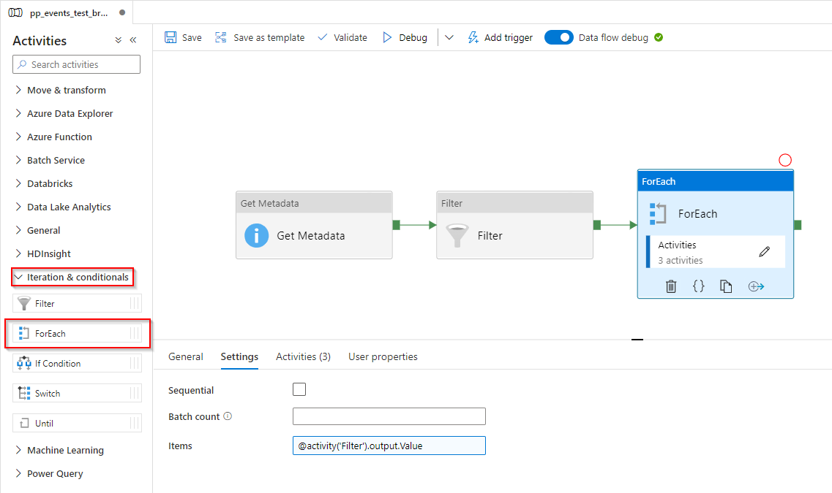
Creation of Pipelines – Add ForEach

Slide 46
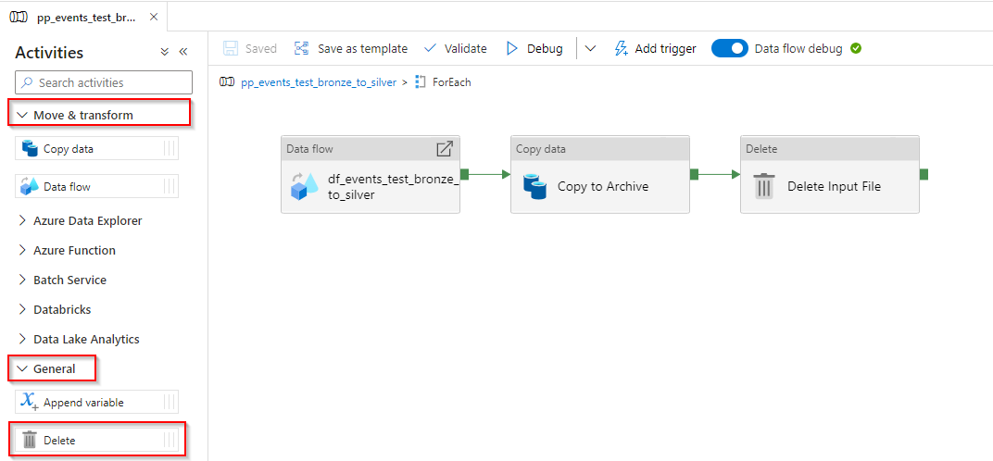
Creation of Pipelines – Add ForEach Activities

Slide 47
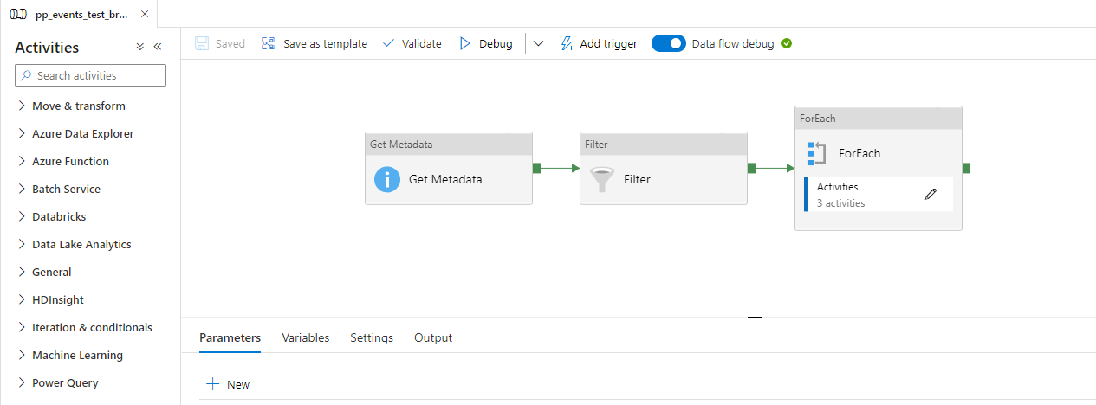
Creation of Pipelines

Slide 48
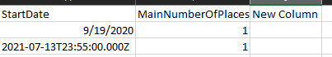

Technical Controls – At Column Level
1. CheckNumOfColumns
An additional column was added to the original file.
As it does not match the expected number of columns, an error message is generated, and the file will be rejected.

Slide 49

Technical Controls – At Row Level
2. CheckMandatory
If the field is mandatory, it's value cannot be NULL.
As it does not match the expected requirement, an error message is generated, and the file will be rejected.

Slide 50
Steps in ADF
Upload File to Azure Blob Storage
Create Working Branch
Create Datasets - (Source, destination)
Create Data Flow - (Technical Transformation of Data)
Create Pipeline & Orchestrate Pipeline
Deployment via Azure DevOps
Scheduling

Slide 51

Deployment
To create a new release, click on Create Release. This will provide the configuration to choose which environment is needed for the new release.

Slide 52

Release
The release is successfully deployed in the QUAL environment.

Slide 53
Steps in ADF
Upload File to Azure Blob Storage
Create Working Branch
Create Datasets - (Source, destination)
Create Data Flow - (Technical Transformation of Data)
Create Pipeline & Orchestrate Pipeline
Deployment via Azure DevOps
Scheduling

Slide 54

Scheduling

Slide 55

Scheduling

Slide 56
Scheduling

Slide 57

Scheduling

Slide 58
Reporting In Power BI

Slide 59





Power BI & Azure
Uses Cube to replicate data in Power BI
Scheduling DONE
Data Updated in SSMS Tool
Data Integration & Managing Relationships in VS tool
Internal Users + Client
Internal Users
DEV Environment (Testing)
PROD Environment

Slide 60
Power BI
After scheduling is done and performed successfully, data are updated in the data-warehouse. Power BI Report uses the ‘view’ in SQL Server Management Studio (SSMS) to be able create interactive dashboards for clients.
Before validating a Power BI (PBI) Report, developers will publish the report into a workspace (DEV Environment) with a specific group of users for testing.
After validation, the PBI Report is then published in the (PROD) Production environment where the client has access. Any modification (calculated measures, charts, etc..) that are further required from the client, are usually done via the tool namely Visual Studio (VS) and in the Power BI itself.

Slide 61
Thank You
Any Questions?

